Slide 1
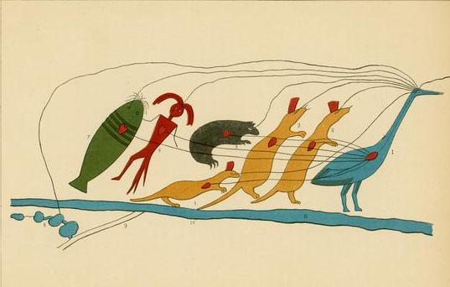
Ojibwe: A Connected People
N A T I O N A L P A R K S E R V I C E • A P O S T L E I S L A N D S N A T I O N A L L A K E S H O R E
Notes:
Ojibwemowin intro and translations

Slide 2
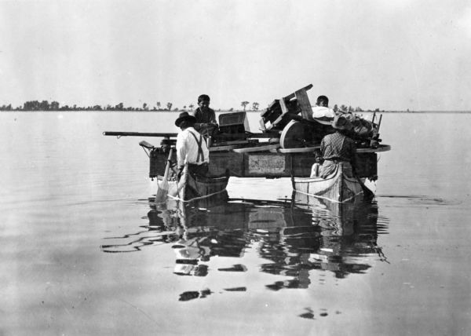
Waawiinjigaade: Explanation
Ojibwe people have lived in this area for thousands of years. The environment has shaped the culture.
The Ojibwe language reveals the ideas, values, thoughts, and connection with the environment.
N A T I O N A L P A R K S E R V I C E • A P O S T L E I S L A N D S N A T I O N A L L A K E S H O R E

Slide 3
Mashkiikii: Medicine
Words were medicine; they were magic and invisible. They came from nothing into sound and meaning. They were beyond price; they could neither be bought or sold.
N. Scott Momaday
N A T I O N A L P A R K S E R V I C E • A P O S T L E I S L A N D S N A T I O N A L L A K E S H O R E

Slide 4
Minotan: Sound
Words represent the ideas, feelings, and wants of a person and, as such, they are more than merely sounds.
Basil H. Johnston
N A T I O N A L P A R K S E R V I C E • A P O S T L E I S L A N D S N A T I O N A L L A K E S H O R E

Slide 5
Niso-initaagwad: Three understandings
What I have found about this language, as I wrote and translated, is that many, if not most, terms and expressions have three meanings.
The first identifies a person, place, thing, idea, or act.
The second signifies the origin of the term or expression from its prefixes and roots, and thereby conveys its etymology.
The third connotes understandings that refer to some insight, ideal, belief, precept, institution, value, concept, or notion.
Basil H. Johnston
N A T I O N A L P A R K S E R V I C E • A P O S T L E I S L A N D S N A T I O N A L L A K E S H O R E

Slide 6
Animate Inanimate
Animate
Animosh:
Dog
Dewe’igan:
Drum
Opwaagan:
Pipe
Indiniigan:
My shoulder blade
Miskomin:
Raspberry
Inanimate
Adoopwin:
Table
Emikwaan:
Spoon
Miin:
Blueberry
Nibi:
Water
Onaagan:
Cup
N A T I O N A L P A R K S E R V I C E • A P O S T L E I S L A N D S N A T I O N A L L A K E S H O R E

Slide 7
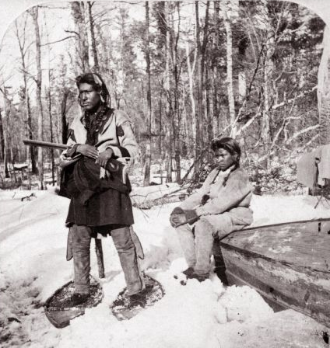
Giizisoog: Moons
Gichi-manidoo-giizis:
January
Namebini-giizis:
February
Onaabani-giizis:
March
Iskigamizige-giizis:
April
N A T I O N A L P A R K S E R V I C E • A P O S T L E I S L A N D S N A T I O N A L L A K E S H O R E
Notes:
Gichi-manidoo-giizis: January - Great Spirit Moon
Namebini-giizis: February – Sucker Moon
Onaabani-giizis: March – Crust on the Snow Moon
Iskigamizige-giizis: April – Sap Boiling Moon

Slide 8
Giizisoog: Moons
Waabigwanii-giizis:
May
Ode’imini-giizis:
June
Miini-giizis:
July
Manoominike-giizis:
August
N A T I O N A L P A R K S E R V I C E • A P O S T L E I S L A N D S N A T I O N A L L A K E S H O R E
Notes:
Waabigwanii-giizis: May –Flowering Moon
Ode’imini-giizis: June – Strawberry Moon
Miini-giizis: July – Berry Moon
Manoominike-giizis: August – Ricing Moon

Slide 9
Giizisoog: Moons
Waatebagaa-giizis:
September
Binaakwii-giizis:
October
Gashkadino-giizis:
November
Manidoo-giizisoons:
December
N A T I O N A L P A R K S E R V I C E • A P O S T L E I S L A N D S N A T I O N A L L A K E S H O R E
Notes:
Waatebagaa-giizis: September – Bright Leaves Moon
Binaakwii-giizis: October – Leaves Falling Moon
Gashkadino-giizis: November – Frozen Over Moon
Manidoo-giizisoons: December – Little Spirit Moon

Slide 10
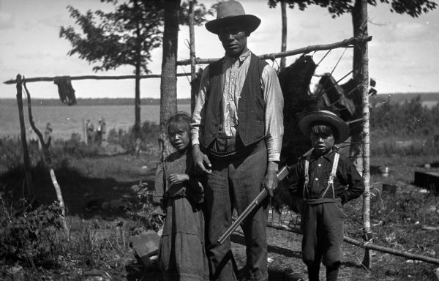
Awensiiyag: Animals
Waawaashkeshi:
White Tail Deer
Waawaabiganoojiinh:
Mouse
Waabizheshi:
Martin
N A T I O N A L P A R K S E R V I C E • A P O S T L E I S L A N D S N A T I O N A L L A K E S H O R E

Slide 11
Awensiiyag: Animals
Esiban:
Raccoon
Ajidamoo:
Squirrel
Bebezhigooganzhii:
Horse
N A T I O N A L P A R K S E R V I C E • A P O S T L E I S L A N D S N A T I O N A L L A K E S H O R E
Notes:
Esiban: used to be, shell
Waabizheshi: white spot on its chest

Slide 12
Awensiiyag: Animals
Makwa:
Bear
Mooz:
Moose
Ma’iinganaance:
Coyote
N A T I O N A L P A R K S E R V I C E • A P O S T L E I S L A N D S N A T I O N A L L A K E S H O R E
Notes:
Esiban: used to be, shell
Waabizheshi: white spot on its chest

Slide 13
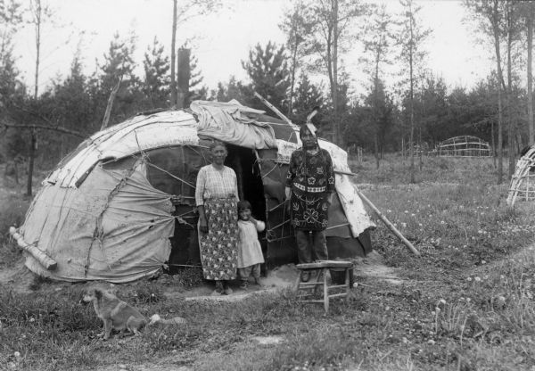
Giigooyag: Fishes
Maashkinoozhe:
Musky
Name:
Sturgeon
Adikameg:
Whitefish
Namebin:
Sucker
N A T I O N A L P A R K S E R V I C E • A P O S T L E I S L A N D S N A T I O N A L L A K E S H O R E
Notes:
Name: one that dwells in the depths, animii’e to pray, to get down
Namebin: bottom feeder

Slide 14
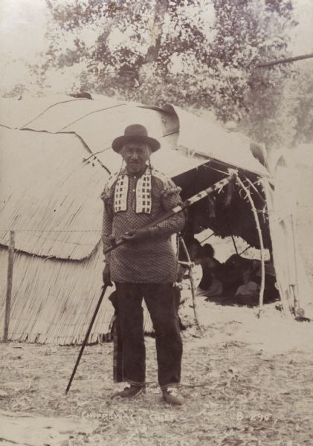
Bineshiinhyag: Birds
Giikidab:
Downy woodpecker
Gaagaagii:
Raven
Gijigijiganeshiinh:
Chickadee
Gookookoo’oo:
Owl
N A T I O N A L P A R K S E R V I C E • A P O S T L E I S L A N D S N A T I O N A L L A K E S H O R E
Notes:
Giikidab: one that goes sideways
Gaagaagii: forever present bird

Slide 15
Bineshiinhyag: Birds
Neenookaasi:
Hummingbird
Giishkimaansii:
Kingfisher
Manoominikeshiinh:
Bobolink
Baaka’akwe:
Chicken
N A T I O N A L P A R K S E R V I C E • A P O S T L E I S L A N D S N A T I O N A L L A K E S H O R E
Notes:
Neenookaasi: the one who stops here and there in flight

Slide 16
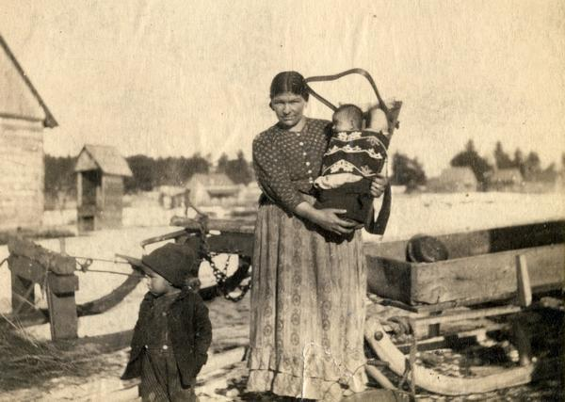
Manidoonsag: Insects
Waawaatesi:
Firefly
Memengwaa:
Butterfly
Zagime:
Mosquito
Ezigwaa:
Woodtick
N A T I O N A L P A R K S E R V I C E • A P O S T L E I S L A N D S N A T I O N A L L A K E S H O R E
Notes:
Waawaatesi: Firefly - Shimmering
Memengwaa: Butterfly – Back and forth
Zagime: Mosquito – To be attached
Ezigwaa: Woodtick – To be attached

Slide 17
Manidoonsag: Insects
Bapakine:
Grasshopper
Disaa-weshiinh:
Cicada
Asabikeshiinh:
Spider
N A T I O N A L P A R K S E R V I C E • A P O S T L E I S L A N D S N A T I O N A L L A K E S H O R E
Notes:
Babakine: jump as in sparks from a fire
Disaa-weshiinh: To be painted

Slide 18
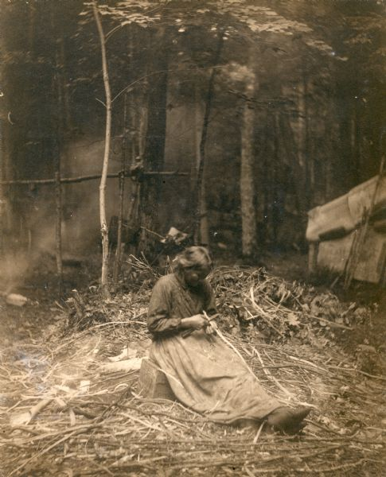
Pedakiidegan: Plants
Giizisoo-bagoons:
Goldenrod
Mewishkode-ikoones:
Bluestem
Ode’imin
Strawberry
Gaabizaan-ideyak
Hepatica
N A T I O N A L P A R K S E R V I C E • A P O S T L E I S L A N D S N A T I O N A L L A K E S H O R E
Notes:
Giizisoo-bagoons: little sun flower
Mewishkode-ikoones: little prarie fire, for indigestion
Gaabizaan-ideyak: that which instills calm

Slide 19
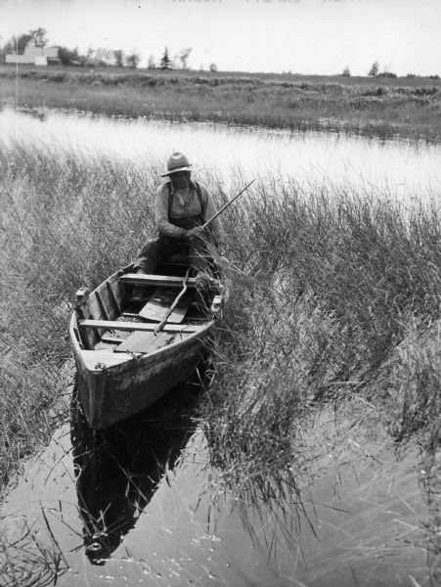
Manoominikewin: Making rice
N A T I O N A L P A R K S E R V I C E • A P O S T L E I S L A N D S N A T I O N A L L A K E S H O R E

Slide 20
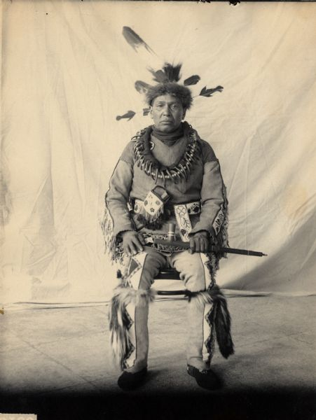
Gegooikewin: Fishing
N A T I O N A L P A R K S E R V I C E • A P O S T L E I S L A N D S N A T I O N A L L A K E S H O R E

Slide 21
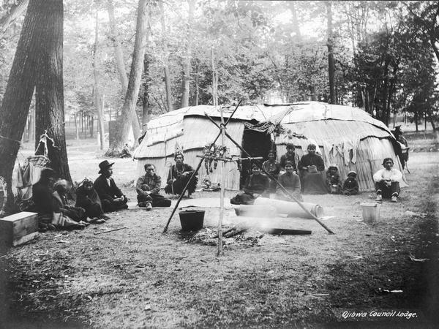
Iskigimizigewin: Making Sugar
N A T I O N A L P A R K S E R V I C E • A P O S T L E I S L A N D S N A T I O N A L L A K E S H O R E

Slide 22
Ishkwe’aayii: Closing
Gakina miziwe Anishinaabe akiing imaa adizokaanan.
Miigwech bizindaawiiyeg!
N A T I O N A L P A R K S E R V I C E • A P O S T L E I S L A N D S N A T I O N A L L A K E S H O R E

